Slide 1







Smart Water Utility
Consumption Monitoring & Anomaly Detection
Presented by
Sanket Dhole

Slide 2













Objective & Problem Statement
Problems Addressed
Objective
No Real-time Consumption Visibility
Build a scalable data platform for real-time water monitoring, anomaly detection, billing, and analytics.
Utility cannot monitor water usage patterns as they happen, leading to delayed responses to issues.
Late Anomaly Detection
Leaks and consumption spikes are detected after significant damage or resource waste has occurred.
Real-time insights
Manual Billing & Poor Analytics
Automated anomaly detection
Outdated systems rely on manual intervention for billing and provide limited analytical insights.
Production-style architecture

Slide 3
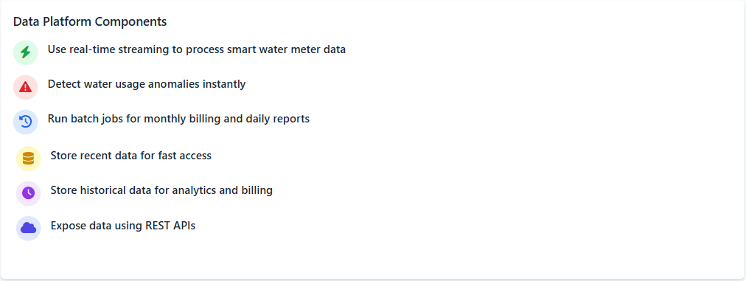
Solution Approach

Slide 4

















Technology Stack Overview
Scala
Akka
Kafka
Functional programming, immutability, case classes
Actor model for massive device simulation
Distributed pub-sub ingestion layer
High throughput, partitioned, fault-tolerant
Safe concurrent data processing with immutable data structures
Scheduler & fault isolation for reliable processing
Spark
Storage Formats
Play Framework
Structured Streaming for real-time anomaly detection
JSON: Lightweight, fast access for recent readings
Asynchronous, non-blocking REST APIs
Reactive & scalable service layer
Spark SQL & Catalyst optimizer for batch analytics
Avro + S3: Schema enforcement, compression, analytics-ready

Slide 5
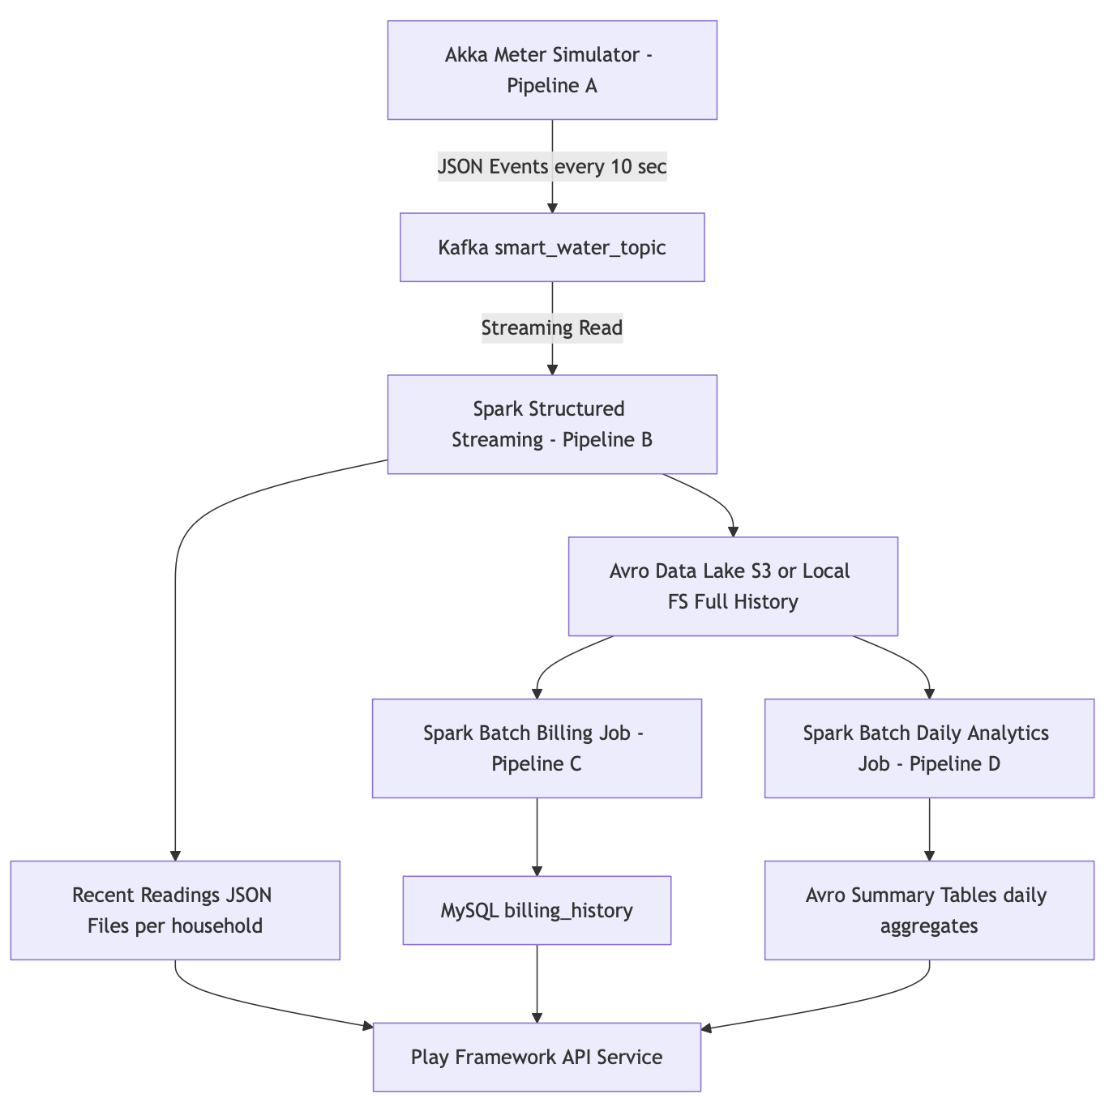
Overall System Architecture

Slide 6












Data Model & Storage Strategy
Multi-layer data storage approach optimized for different use cases:
Layer
Tool / Storage
Data
Why Used
Operational
MySQL
customer, household, billing_plan, billing_history
ACID transactions
Relational joins for billing
Streaming Ingestion
Kafka
smart_water_readings events
High-throughput
Fault-tolerant event backbone
Device Simulation
Akka
Synthetic meter events
Actor-based concurrency
Scalable simulations
Real-Time Processing
Spark Streaming
Enriched meter readings
Low-latency stream processing
At-scale anomaly detection
Serving Layer
JSON Files
Latest 50 readings per household
Lightweight, fast read
Dashboard & API response

Slide 7









Pipeline A - Meter Simulation
Akka Actors
Kafka
Simulate water meters
Message broker
Implementation
Key Features
Time-based patterns: Daily, weekly cycles
Actor model: Concurrent simulations
Anomaly injection: 2% of readings
Scheduler: Controlled generation

Slide 8


















Pipeline B - Real-Time Processing
Spark Streaming
Kafka
JSON + Avro
Message Broker
Stream Processing
Storage
Parse
Validate
Detect Anomaly
Write
Convert raw messages into structured data
Ensure data integrity and format consistency
Identify consumption spikes/drops using statistical methods
Store results in JSON and Avro formats
Anomaly Detection Method
Statistical analysis using mean ± 3σ (standard deviation)
Spike detection: consumption exceeds mean + 3σ
Drop detection: consumption falls below mean - 3σ
Low-latency streaming writes for real-time insights

Slide 9
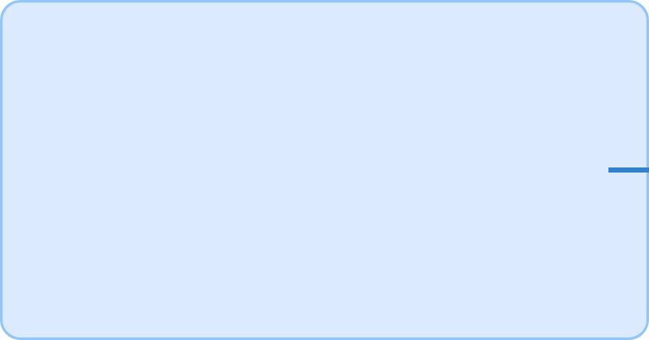


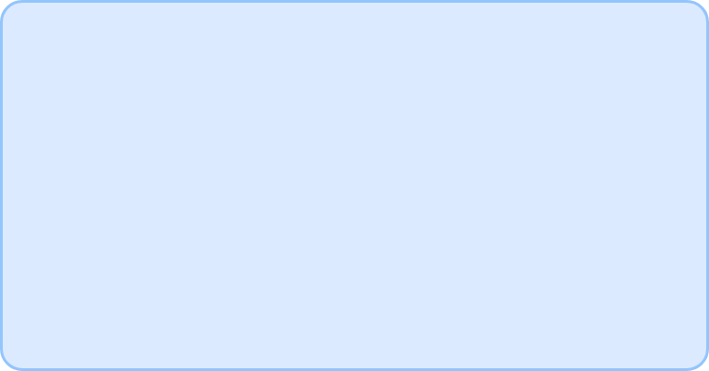














Pipeline C - Monthly Billing
Avro
Storage format
Aggregate
Billing History
Data aggregation
Output
MySQL
Billing plans
Pipeline Components
Key Features
Spark Batch
Batch ETL Process
Processes historical data for billing calculations
Demonstrates production-style batch processing for billing
Data Aggregation
Heavy Aggregations
Groups consumption data by household and time period
Calculates monthly totals and applies billing rules
MySQL Integration
Referential Integrity
Joins with billing plans for rate calculations
Ensures accurate billing through proper joins

Slide 10













Pipeline D - Daily Reports
Readings
Daily Aggregates
Avro Tables
Raw meter data
Spark Batch
Analytics storage
Implementation Details
Usage & Benefits
Spark Batch job processes daily aggregates
Used by dashboards for visualization
Writes results to Avro format tables
Exposed through REST APIs
Uses S3 for storage
Daily processing window

Slide 11


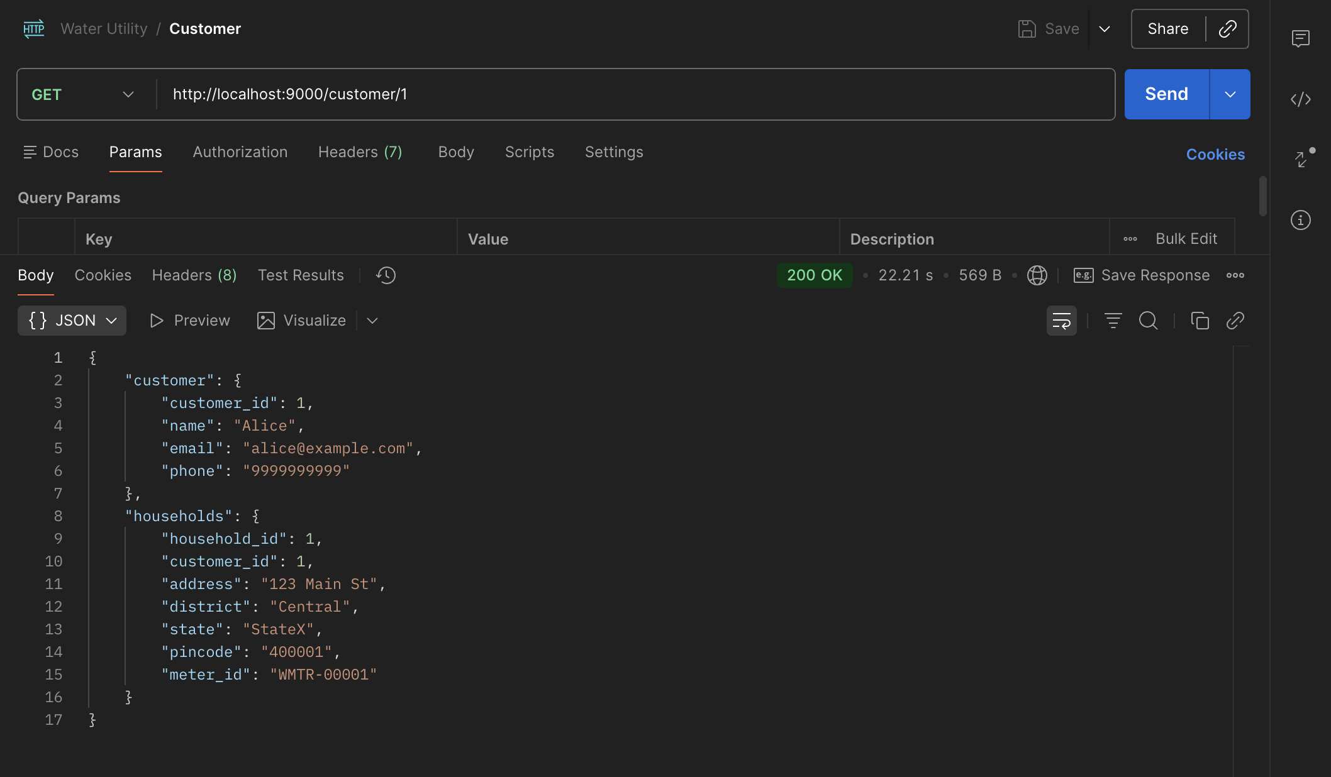
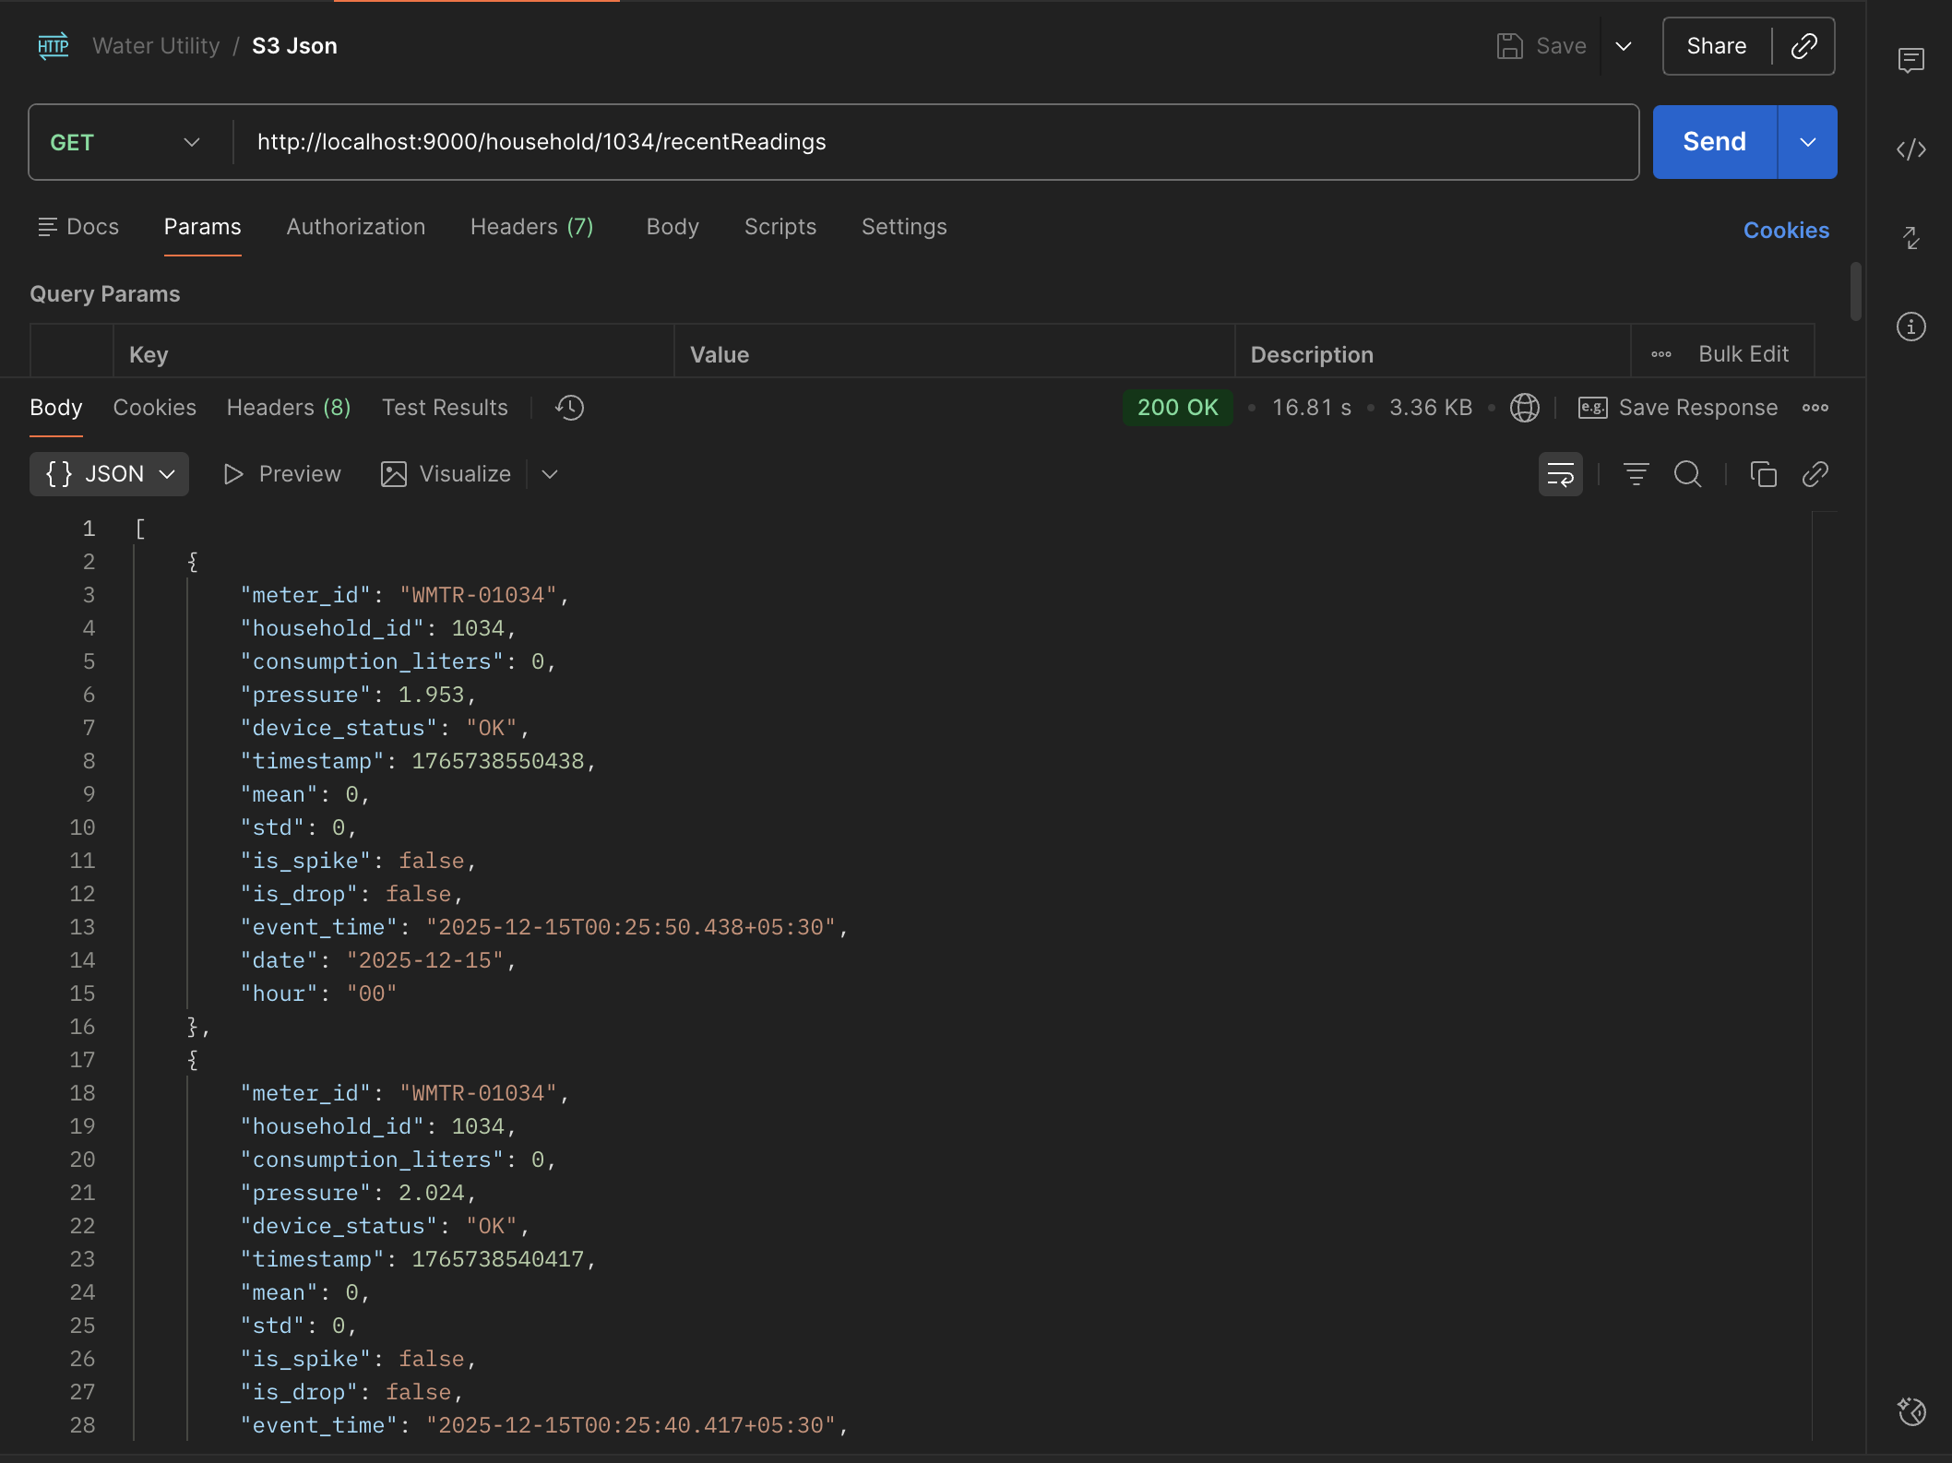
REST API Services
GET
/customer/{id}
GET
/household/{id}/recentReadings

Slide 12

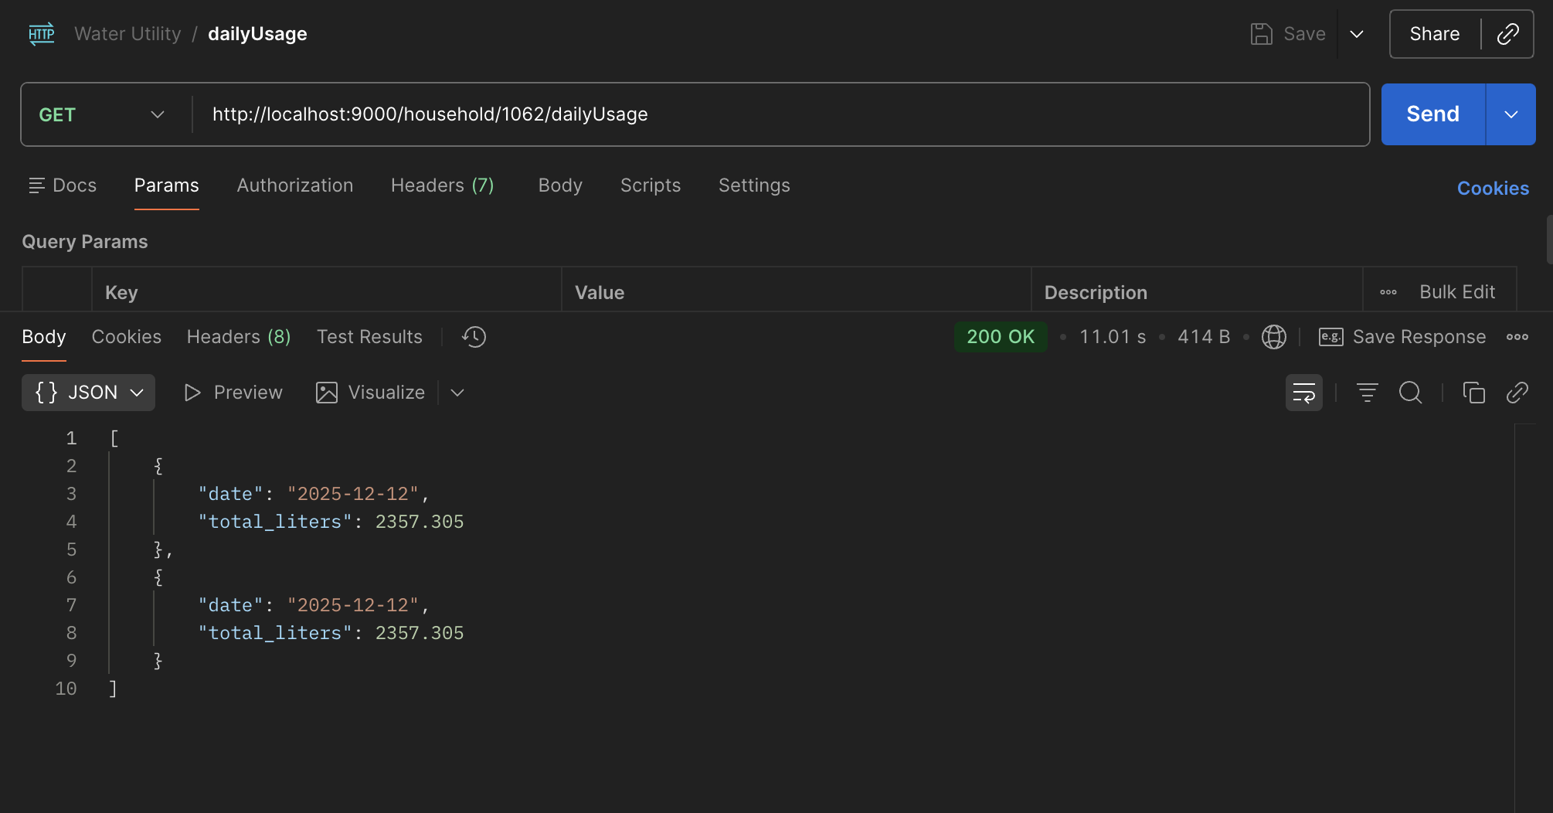
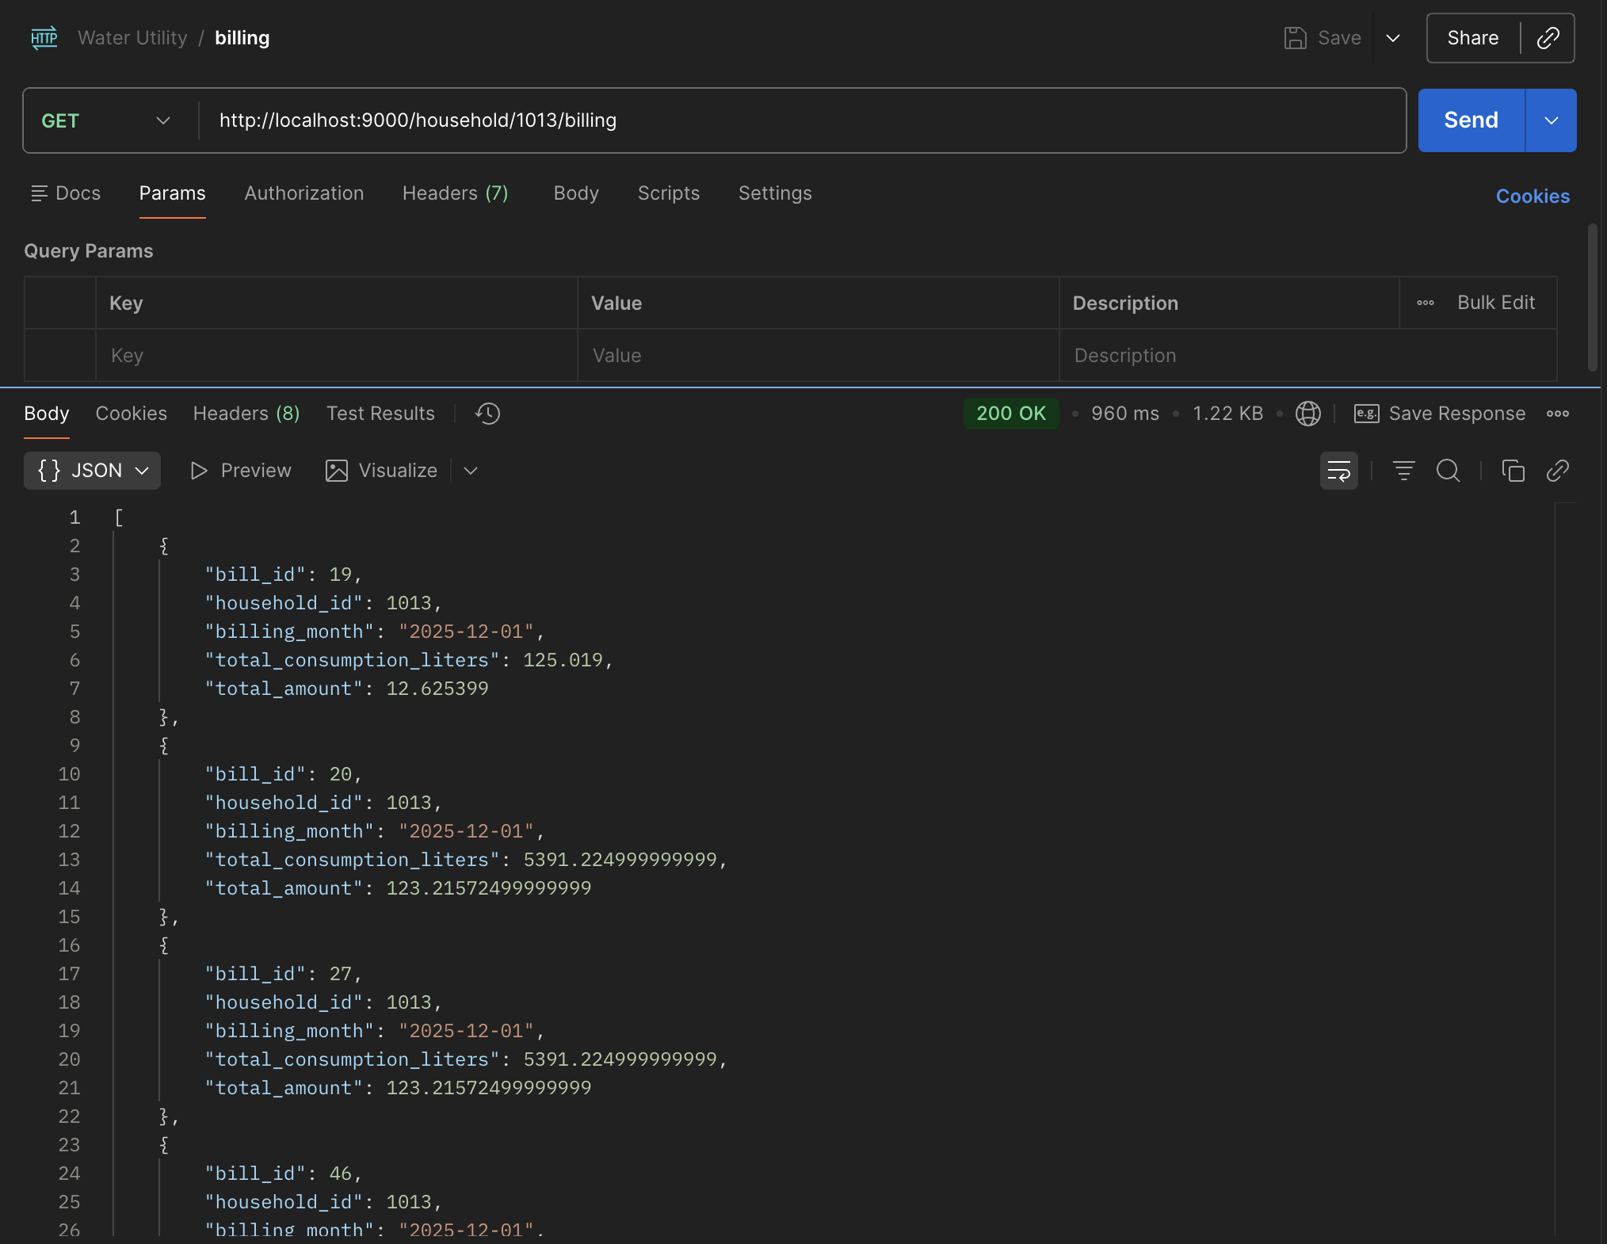
REST API Services
GET
/household/{id}/dailyUsage
GET
/household/{id}/billing

Slide 13
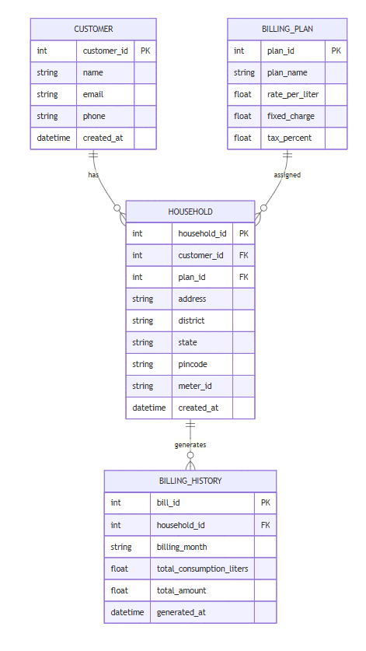





Database Schema & Relationships
MySQL operational data model for water utility billing and customer management.
Customer-Household Relationship
One customer can own multiple households
Household-Billing Plan
Each household has exactly one billing plan
Household-Billing History
Each household generates multiple bills
Referential Integrity
Foreign keys enforce relationships

Slide 14














Project Conclusion
Platform Capabilities
Architecture Highlights
Real-time water consumption monitoring with low-latency processing
Multiple storage systems for different access patterns
Integration of streaming and batch processing
Anomaly detection for leaks and spikes using statistical modeling
Production-style big data architecture
Automated billing system with batch ETL processes
Future Benefits
Technical Achievements
Reduced water waste through early anomaly detection
Improved customer service with accurate billing
End-to-end implementation
Data-driven insights for utility optimization
Scalable design supporting massive device simulation
Fault-tolerant data processing across the platform
Key Takeaway: Successfully implemented a real-time + batch data platform with scalable, fault-tolerant design suitable for production environments.

Slide 15





















Thank You
For questions and discussion about the Smart Water Utility Platform
Scala
Akka
Kafka
Spark
JSON/Avro
Real-time Insights
Anomaly Detection
Scalable Architecture
Immediate visibility into water consumption
Early identification of leaks/spikes
Production-style data platform
Questions?

